Slide 1

Heart Disease Prediction Using Machine Learning

Slide 2
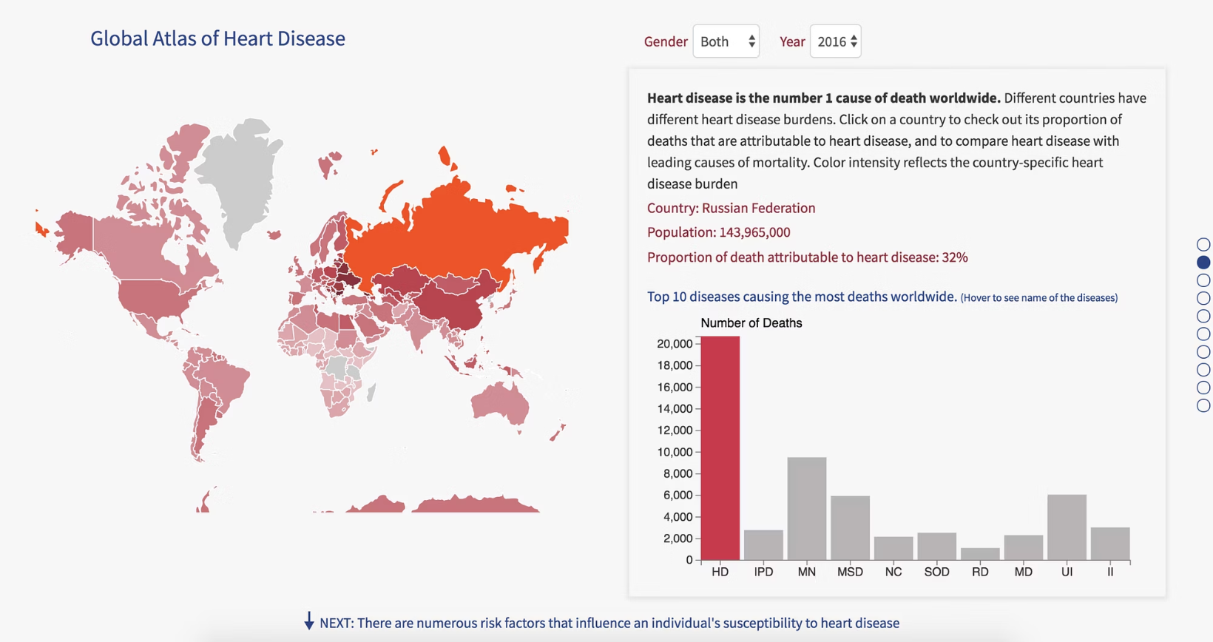

The Critical Healthcare Challenge
Cardiovascular disease remains the leading global cause of mortality, claiming 17.9 million lives annually according to WHO data.
Traditional diagnostic methods are resource-intensive, requiring specialist expertise and expensive equipment often unavailable in rural communities.
Early detection through accessible screening tools could dramatically reduce mortality rates and healthcare costs.

Slide 3
Our Mission & Objectives
Accurate Prediction
Accessible Tools
Develop robust AI models achieving high sensitivity and specificity in cardiovascular risk assessment
Create intuitive screening applications for healthcare professionals and at-risk populations
Early Detection
Cost Efficiency
Enable proactive identification of cardiovascular risks before clinical manifestation
Reduce healthcare expenditure through preventive screening and optimised resource allocation

Slide 4
Dataset Foundation
1000
14
13
Patient Records
Medical Parameters
Input Features
Comprehensive clinical data from real medical examinations
Including demographics, symptoms, and diagnostic test results
Plus one target variable indicating disease presence
Data sourced from the prestigious Cleveland Heart Disease Dataset (UCI Machine Learning Repository), ensuring clinical validity and research reproducibility. Data sourced from the prestigious Cleveland Heart Disease Dataset (UCI Machine Learning Repository), ensuring clinical validity and research reproducibility. The dataset is widely recognized in the medical and machine learning community for benchmarking predictive models. It contains well-structured and standardized patient records, enabling effective training, testing, and comparison of algorithms. Its reliability and real-world relevance make it ideal for developing accurate and scalable heart disease prediction systems.

Slide 5
Machine Learning Methodology
01
02
Random Forest Implementation
Data Stratification
Ensemble learning approach combining multiple decision trees for robust predictions and reduced overfitting
70-30 train-test split maintaining class distribution balance for unbiased model evaluation
03
04
Feature Engineering
Python Integration
Comprehensive scaling and cross-validation techniques ensuring optimal model performance
Scikit-learn framework providing reliable, industry-standard machine learning capabilities

Slide 6



System Architecture Overview
Tkinter GUI
Provides an intuitive layout for entering patient health parameters
Includes input validation to ensure accurate data collection
Python Pipeline
Performs data preprocessing (handling missing values, normalization, feature selection)
Integrates machine learning models like Logistic Regression and Decision Trees
Clinical Output
Displays prediction outcome (High Risk / Low Risk) clearly
Provides probability scores for better understanding

Slide 7
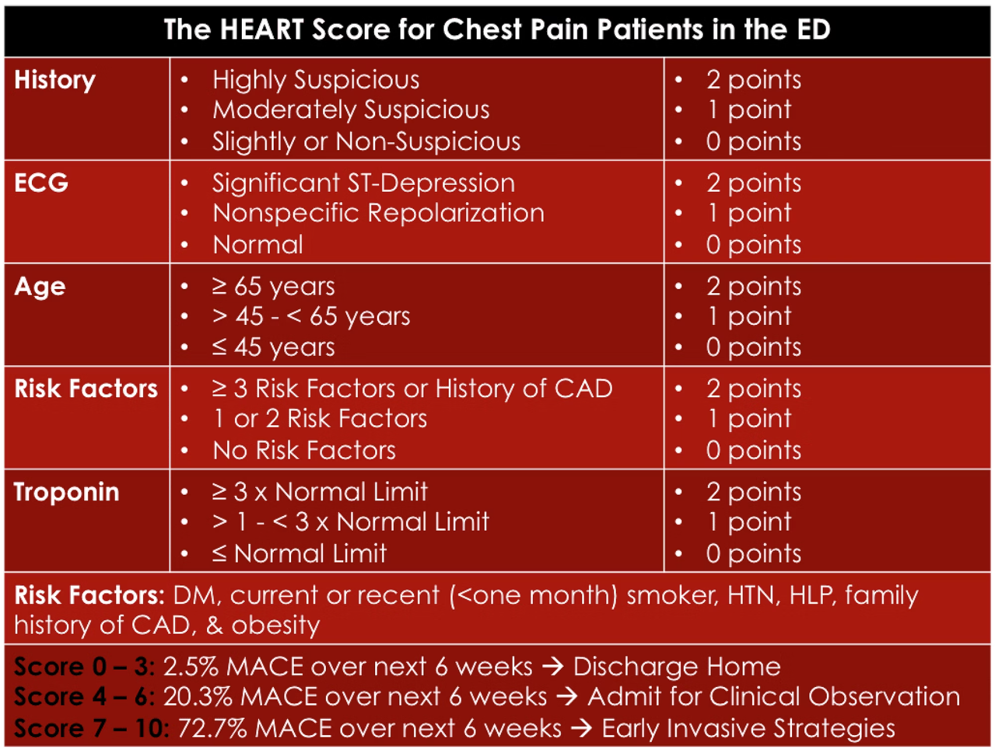
Clinical Parameters & Features
Patient Demographics
Age and biological sex
Medical history indicators
Lifestyle risk factors
Cardiovascular Metrics
Resting blood pressure
Serum cholesterol levels
Maximum heart rate achieved
Diagnostic Indicators
Chest pain classification
Exercise-induced angina
ECG abnormalities
ST depression measurements
Major vessel involvement

Slide 8



Clinical Impact & Benefits
Enhanced Diagnostics
Improved Access
Preventive Care
Supports clinical decision-making with evidence-based risk stratification and diagnostic confidence intervals
Extends specialist-level screening capabilities to underserved communities and primary care settings
Enables proactive intervention strategies, potentially preventing acute cardiovascular events and hospitalisations

Slide 9

Future Directions & Conclusion
1. Validation Studies
Multi-centre clinical trials to validate model performance across diverse patient populations
2. Integration Pathways
Electronic health record integration and mobile health platform development
3. Regulatory Approval
Pursuing medical device certification for clinical deployment and widespread adoption
Machine learning represents a paradigm shift towards predictive, personalised cardiovascular medicine - enabling earlier intervention and improved patient outcomes through accessible, evidence-based risk assessment tools.

